Slide 1
Data Structures and Algorithms -3 (25CS2103E)
Resume–Job Matching & Talent Marketplace Engine
Team Members
M. Harshika – 2520090047
Ch. Madhulika – 2520090056
Under the Esteemed Guidance of
Mrs. Ch. Anitha, Asst. Professor, CS&IT

Slide 2
Abstract
The Resume–Job Matching & Talent Marketplace Engine is a comprehensive platform designed to simulate real-world recruitment systems by integrating multiple functional modules. In today's dynamic job market, students often lack clarity on their eligibility, while recruiters face challenges in screening numerous resumes.
The system includes a student module for profile creation and resume upload, where key information such as skills, education, and projects is extracted, and a recruiter module for posting job requirements. The core component is the matching engine, which uses data structures and algorithms like hashing, string matching, and priority queues to compare skills and rank candidates based on compatibility scores.
Additional features such as skill gap analysis, career roadmap generation, and mock interview preparation enhance its practical value — helping students improve employability while enabling efficient and accurate candidate selection for recruiters.

Slide 3
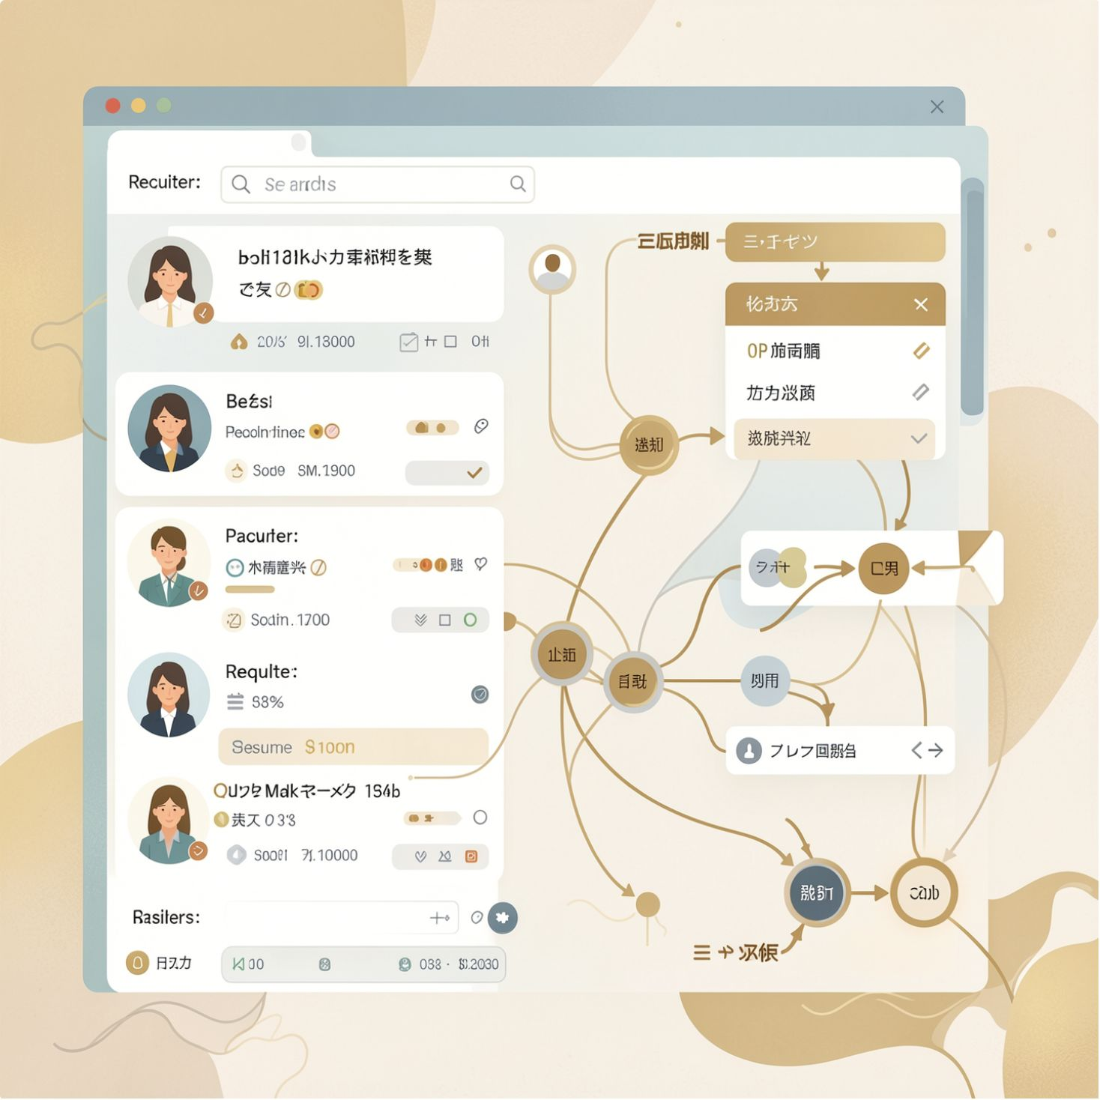
Introduction
Large job marketplaces create two parallel challenges:
Candidates struggle to find relevant postings among many noisy results.
Recruiters expend substantial time screening resumes with low precision.
This project applies data-structure-driven organization plus search and ranking algorithms to improve precision and speed of recommendations.

Slide 4
Literature Survey
Traditional Portals: Large listings but high irrelevance; keyword matching yields many false positives.
Keyword Matching: Fast and simple, but lacks semantic context and weighted importance of skills.
Recommendation Platforms: Personalization works at scale but often needs large behavioral datasets and complex tuning.
Proposed DSA Approach: Combines structured storage, algorithmic search, and ranking heuristics to be efficient, interpretable, and extendable with AI.
Research gap: an efficient, explainable pipeline combining organization, search, matching, and ranking for mid-sized datasets without heavy ML dependencies.

Slide 5
Problem Statement and Objectives
Problem Statement
Efficiently store candidate and job records for quick access.
Search and retrieve relevant jobs for a candidate using algorithmic techniques.
Compute interpretable matching scores comparing skills, qualifications, and experience.
Sort and rank results so the most suitable opportunities surface first.
Challenges addressed: scale of listings, manual screening effort, irrelevant recommendations, and ranking by suitability as data grows.
Objectives
Design compact, indexable representations for resumes and job descriptions.
Implement search routines that leverage hashing and sorted indexes.
Define a clear skill-based match score with experience/qualification weights.
Apply efficient sorting and top-k retrieval for ranked recommendations.
Demonstrate practical DSA usage with examples and complexity analysis.

Slide 6
Flow Chart
Extract
Structure
Index
Search
Compare
Recommend
The pipeline transforms raw resumes into structured records, indexes them for fast lookup, computes a normalized match score, and returns the top-k ranked job recommendations.
Example: Candidate skills = {Java, SQL, HTML, DSA}; Job requires = {Java, SQL, DSA, Python}
Matches = 3/4 → Match Score = 75% (extendable with weights for experience and qualification).

Slide 7
Results
Data Structures & Algorithms Used
HashMap: O(1) average lookup for skill presence/frequency; used for candidate skill vectors and inverted indexes.
Array / ArrayList: Stores ordered records; used with binary search after sorting by key attributes.
Priority Queue / Heap: Efficient top-k retrieval (O(n log k)) to return best matches without a full sort.
Binary & Linear Search: Binary search on sorted attributes (e.g., experience); linear scan with pruning for composite queries.
Sorting (merge/quick): Ranks candidates by computed match scores.
Sample Ranked Output — Candidate: Harshika
Java Developer — 85%
Software Developer — 75%
Web Developer — 65%
Data Analyst — 50%
Scores are deterministic given the same inputs (skill overlap + weighting rules); mock data shown, to be replaced with live system output.

Slide 8
Hardware and Software requirements
Hardware
Laptop / Desktop computer
Minimum 4 GB RAM
i3-equivalent CPU or higher
Software
Java runtime environment
IDE: VS Code / IntelliJ IDEA
Optional web stack: HTML, CSS, JavaScript
Database: MySQL / MongoDB
Version control: Git / GitHub for collaboration

Slide 9
Conclusion
Efficient data structures combined with targeted algorithms deliver fast, explainable match scores that improve recruiter throughput and candidate relevance.
The engine offers a concise, production-ready pipeline for matching candidate resumes to open positions using structured data, efficient algorithms, and clear ranking logic — built for hiring managers, recruiters, and students alike.
Additional features like skill-gap analysis, career roadmaps, and mock-interview preparation add practical value for candidates while keeping recruiter screening fast and accurate.

Slide 10
Future Scope
Short-Term Roadmap
Add weighted skill importance and experience-decay factors.
Integrate semantic matching (embeddings) as an optional module.
Evaluate on a labeled dataset and measure precision@k and recall.
Optimize ranking thresholds and indexing for incremental updates.
Long-Term Vision
Personalized recommendations via an ML-driven career assistant.
Recruiter analytics dashboards for hiring insights.
Mobile-first experience backed by cloud storage.
Scalable indexing for large-scale deployment.

Slide 11
Thank you

